Slide 2
Unit 1 : All about Networks
Notes:
2

Slide 3
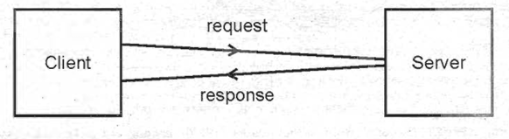
What is a Network?
Definition: The interconnection of two or more computers.
Purpose: The primary purpose is resource sharing (data, software, hardware, CPU).
Client/Server Architecture:
Client: Requests a service.
Server: Provides a service.

Slide 4
Network Requirements
Hardware: Computer systems, NICs, cables, modems, hubs, satellites.
Software: Operating systems that support networking (Unix, Linux, Windows NT).
Protocols: Standard procedures for data transmission (e.g., TCP/IP, UDP, HTTP, FTP, SMTP, POP).

Slide 5
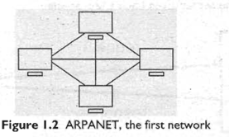
What is the Internet?
Definition: A global network of all computers on Earth.
Sometimes called a "network of all networks."
Origin: Started in 1969 as ARPANET, a US military defense network with 4 connected computers.

Slide 6
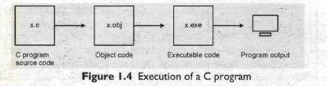
System Dependency Problems
C/C++ programs are system dependent.
An executable (.exe) file created for one processor/OS cannot run on a different one.
Problem: The Internet is a heterogeneous network with different processors and operating systems. C/C++ is not suitable for Internet software.

Slide 7
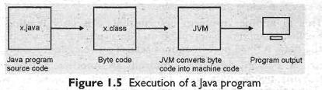
How Java Solves the Problem
java is a system independent language.
Java source code (.java) is compiled into byte code (.class).
Byte code is a fixed set of instructions, system independent.
JVM (Java Virtual Machine): A program that converts byte code into machine code specific to the computer's processor and OS.

Slide 8
Java and Internet Security
Java is designed to eliminate common Internet security problems.
Eavesdropping: Solved with encryption and decryption.
Tampering: Solved with encryption, preventing modification.
Impersonation: Solved with digital signatures to verify the sender's identity.
Viruses: JVM can verify code before execution, preventing viruses from spreading through Java class files.

Slide 9
Unit 2 : Introduction to java
Notes:
9

Slide 10
Introduction to Java
Origins: The "Green Project" by Sun Microsystems Inc. (1990)
Goal: Develop a system-independent language for consumer electronic devices.
Initial Name: Oak, changed to Java.
Why "Java"? Named after the team's favorite tea.

Slide 11
The Rise of Java
WebRunner: A Java-based web browser, later named HotJava (1994).
HotJava's innovation: The first browser to execute applets, small programs that run dynamically on the Internet.
Browser Support: Netscape and Microsoft soon incorporated Java support, solidifying its role on the web.
Impact: Java becomes a pervasive and widely used language.

Slide 12
Features of Java: Simplicity and OOP
Simple: Designed to be easy to learn and use. Difficult concepts from C/C++ (like pointers) were eliminated to reduce confusion and improve security.
Object-Oriented: Based on classes and objects.
Objects: Real-world entities with properties (variables) and behaviors (methods).
Classes: A blueprint or model for creating objects.

Slide 13
Features of Java: Distributed and Robust
Distributed: Programs can be written to capture and distribute information across a network.
Robust: Java programs are strong and don't crash easily.
Reasons for robustness:
Excellent exception handling for runtime errors.
Automatic memory management by the JVM, preventing common memory allocation issues.

Slide 14
Features of Java: Portable and Secure
Portable: Java programs yield the same results on any machine, thanks to its system-independent nature.
Secure: Designed to minimize Internet security threats.
Eavesdropping & Tampering: Prevented through encryption.
Impersonation: Solved with digital signatures.
Viruses: JVM verifies byte code before execution, preventing virus threats.

Slide 15
The Java Virtual Machine (JVM)
Function: Responsible for converting Java byte code into machine code that can be executed by a microprocessor.
Architecture: Includes several components.
Class Loader Subsystem: Loads, verifies, and allocates memory for class files.
Runtime Data Areas: Memory areas used to store data and results during program execution (Method Area, Heap, Java Stacks).
Execution Engine: Contains the Interpreter and JIT (Just In Time) compiler.

Slide 16
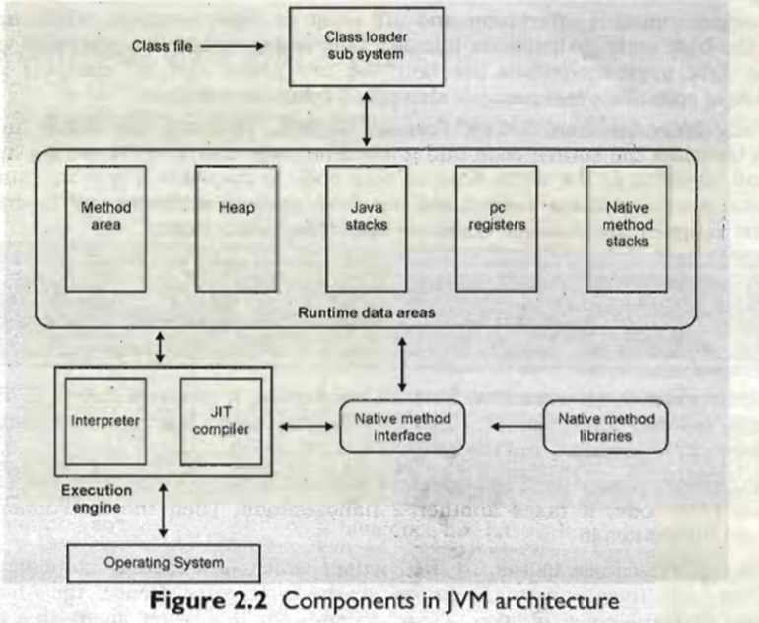
jvm

Slide 17
JVM Execution: Interpreter vs. JIT Compiler
Interpreter: Converts byte code instructions into machine code one at a time. This is efficient for non-repetitive code.
JIT Compiler: Converts frequently executed code blocks (hotspots) into optimized machine code. This significantly increases execution speed.
Collaboration: Both work simultaneously to provide high performance.

Slide 18
C++ vs. Java: A Comparison
Object-Oriented: Java is purely object-oriented (requires a class), while C++ is not.
Pointers: Not available in Java; they are available in C++.
Memory Management: Java's JVM handles memory automatically (garbage collection), while C++ requires the programmer to manage it manually.
Other features:
Java has no goto statement, multiple inheritance, or operator overloading.
Java has 4 access specifiers (private, public, protected, and default), C++ has 3.

Slide 19
The Three Parts of Java
Java SE (Standard Edition): Contains the basic core classes for developing standard applications and applets.
Java EE (Enterprise Edition): Extends Java SE with classes for providing business solutions on a network.
Java ME (Micro Edition): Designed for developers creating code for portable devices like PDAs and cell phones, where code size and memory are limited.

Slide 20
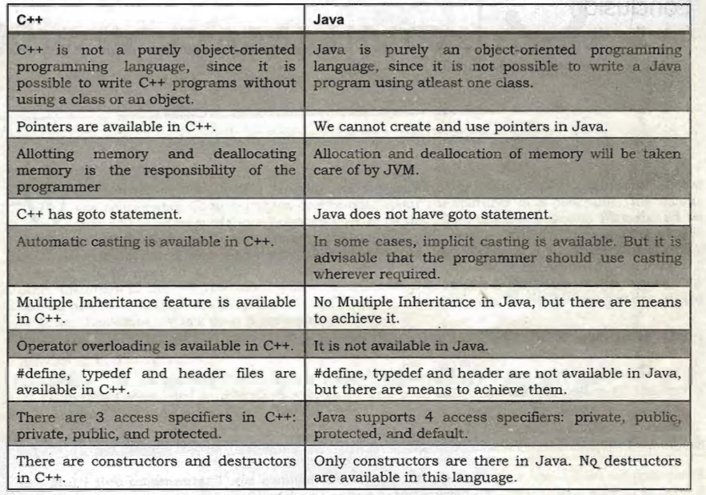
Differences between c++ andJava:

Slide 21
Unit 3: First step towards java programming
Notes:
21

Slide 22
Introduction to Java Programming
Why write comments?
They describe program features.
Improve code readability and understanding for yourself and others.
A good programming habit.
Comments are ignored by the compiler.
Three types of comments in Java.

Slide 23
Types of Java Comments
Single-line comments:
Starts with //
Everything after // on that line is a comment.
Example: // This is a single-line comment.
Multi-line comments:
Starts with /* and ends with */.
Everything between the /* and */ is a comment.
Example: /* This is a multi-line comment. */
Java documentation comments:
Starts with /** and ends with */.
Used to create API documentation.

Slide 24
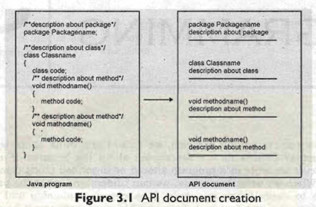
API Documents
What is an API document?
A .html file that describes all features of a software or technology.
Acts like a help file for developers.
How are they created?
Generated from Java documentation comments using the javadoc compiler.
Purpose: Helps users understand how to use classes and methods in a program.

Slide 25
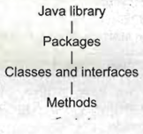
Importing Classes
What is importing?
Making classes from the Java library available in your program.
Difference from C/C++ #include:
#include copies entire header file code, increasing program size.
import tells the JVM where to find the class; no code is copied, which is more efficient.
How to import:
import java.lang.System; (to import a single class)
import java.lang.*; (to import all classes from a package)

Slide 26
The main() Method
Every Java program must have at least one class.
The main() method is the starting point of execution for the JVM.
Structure: public static void main(String args[])
Why public? So the JVM can access it.
Why static? So you don't need to create an object to call it.
Why void? It doesn't return any value.
String args[] is an array that stores command-line arguments as strings.

Slide 27
Displaying Output
Use System.out.print() or System.out.println() to display output.
System.out is an object that represents the standard output device (your monitor).
print() vs. println():
print() displays output and keeps the cursor on the same line.
println() displays output and moves the cursor to the next line.
You can combine strings and variables using the + operator.

Slide 28
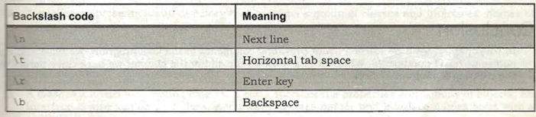
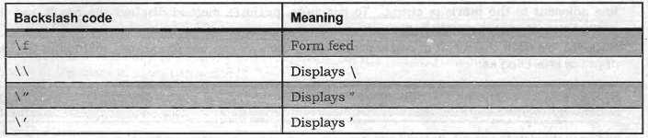
Backslash Codes
Backslash codes are also known as escape sequences.
They are used inside strings to format the output.
Example: \n is used to move the cursor to a new line.
Code Example: System.out.print("Line 1\nLine 2"); will display the text on two separate lines.

Slide 29
Variables and Operators
Variables:
Represent memory locations to store data.
Must be declared with a data type before use.
Example: int x, y;
Operators:
Symbols that perform operations on variables.
= (Assignment Operator): Stores a value from the right into the variable on the left.
+ (Addition Operator): Used for adding numbers or joining strings and variables.

Slide 31
Unit 4: Naming conventions and data type
Notes:
31

Slide 32
Naming Conventions
Naming conventions specify the rules 'to be followed by a Java programmer while writing the names of packages, classes, methods, etc
Packages: Use all lowercase letters (e.g., java.lang).
Classes and Interfaces: Each word starts with a capital letter (e.g., MyClass, MyInterface).
Methods: The first word is lowercase; subsequent words start with a capital letter (e.g., calculateSum()). Distinguished from variables by parentheses ().
Variables: Same convention as methods (e.g., studentName).
Constants: Use all capital letters (e.g., PI, MAX_VALUE).
Keywords: Use all lowercase letters (e.g., int, class).

Slide 33
Data Types
Java provides various data types to store different kinds of data.

Slide 34
Primitive Data Types
Integer Types:
byte: 1 byte, -128 to +127
short: 2 bytes, -32768 to +32767
int: 4 bytes, -2147483648 to +2147483647
long: 8 bytes, -9223372036854775808 to +9223372036854775807 (Use L suffix for long literals, e.g., 150L).
Floating-Point Types:
float: 4 bytes, stores single-precision floating-point numbers (up to 7 decimal digits). Use F suffix (e.g., 3.142F).
double: 8 bytes, stores double-precision floating-point numbers (up to 15 decimal digits). Default for floating-point literals.
Character Type:
char: 2 bytes, stores a single character (Unicode). Range: 0 to 65535 (ASCII values). Character literals are enclosed in single quotes (e.g., 'x'). Supports Unicode for representing characters from various languages.
Boolean Type:
boolean: Represents true or false. JVM uses 1 bit internally.

Slide 35
String Data Type
String: Represents a sequence of characters. String literals are enclosed in double quotes (e.g., "New Delhi"). Treated as an object of the String class.
e.g :
String str = “parmanand”;

Slide 36
Boolean Data types
Boolean data types represent any of the two values true of false .
Jvm uses 1 bit to represent it
Example:
Boolean response = true

Slide 37
Literals
Literals
Literals represent fixed values stored directly into variables.
Integer Literals: Decimal (e.g., 100), Octal (prefix 0, e.g., 0144), Hexadecimal (prefix 0x, e.g., 0x64).
Float Literals: Fractional numbers (e.g., 2.0, 3.14). Use E or e for scientific notation, F or f for float, and D or d for double (default).
Character Literals: Enclosed in single quotes (e.g., 'A', '?'). Supports Unicode (e.g., \u0042) and escape sequences (e.g., \n).
String Literals: Enclosed in double quotes (e.g., "Hello").
Boolean Literals: true or false.

Slide 38
Unit 5: Operator in java
Notes:
38

Slide 39
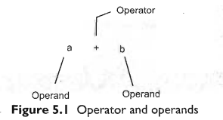
Operators
Operators are symbols that perform operations on variables (operands) to achieve a desired result.
Operators are classified based on the number of operands they act upon:
unary (one operand),
binary (two operands),
ternary (three operands).
If an operator acts on a single variable, it is called unary operator;
if it acts on two variables, it is
called binary operator;
and if it acts on three variables, then it is called ternary operator

Slide 40
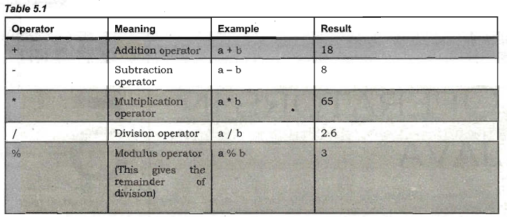
Arithmetic Operators

Slide 41
Unary Operators
unary operators act on only one operand. There are 3 kinds of unary operators:
o -Unary minus operator ( - )
o Increment operator ( ++ )
o Decrement operator ( -- )

Slide 42
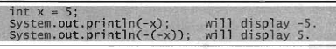
Unary Minus Operator (-)
This operator is used to negate a given value. Negation means converting a negative value intopositive and vice versa, for example

Slide 43
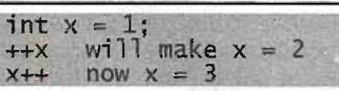
Increment Operator (++)
This operator increases the value of a variable by 1

Slide 44
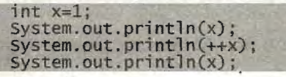
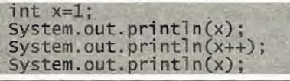
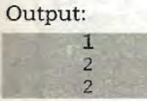
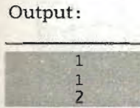
difference between pre- and post- increment of x

Slide 45
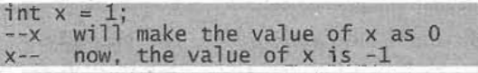
Decrement Operator (--)
This operator is used to decrement the value of a varIable by 1.

Slide 46
Assignment Operator (-)
This operator is used to store some value into a variable. It is used in 3 ways
It is used to store a value into a variable, for example int x = 5;
It is used to store the value of an expression into a variable, for example
It is used to store the value of an expression into a variable, for example:

Slide 47
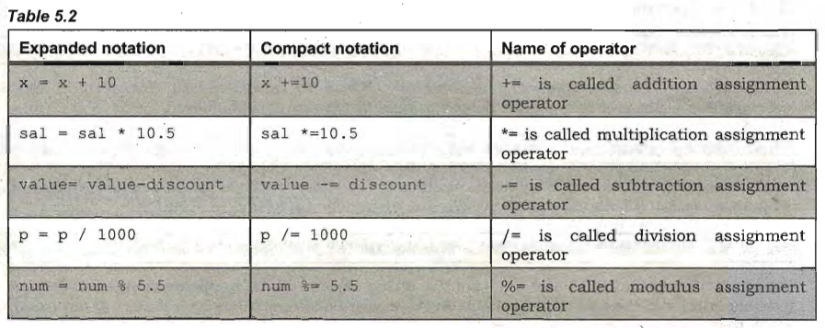
Compact Notation

Slide 48
Relational Operator
These operators are used for the purpose of comparing
o > greater than operator
o >= greater than or equal to
o < less than operator
o <= less than or equal to
o equal to operator
o .! = not equal to operator

Slide 49
Logical Operators
Logical operators are used to construct compound conditions. A compound condition is a
combination of several simple conditions. Logical operators are of three types:
o && and operator
o I I or operator
o not operator

Slide 50
Boolean Operators
These operators act on boolean variables and produce boolean type result. The following 3 type
boolean operators:
o &boolean and operator
o Iboolean or operator
o ! boolean not operator

Slide 51
Bitwise operators
There are 7 types of bitwise operators. Read on to understand them. Let us now discuss them one by one

Slide 52
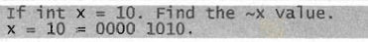
Bitwise Complement Operator ( ~ )
This operator gives the complement form of a given number.
This operator symbol is ~, which is pronounced as tilde
By changing O's as l's and vice versa, we get 1111 0101. This is nothing but –ll (in decimal). SO,~x
= -11.

Slide 53
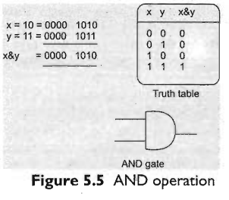

Bitwise and Operator ( & )
This operator performs and operation on the individual bits of the numbers
The symbol for this operator is &, which is called ampersand.
From the truth table, by multiplying the bits, we can get X&y = 0000 1010. This is nothing but 10 O(in decimal)

Slide 54
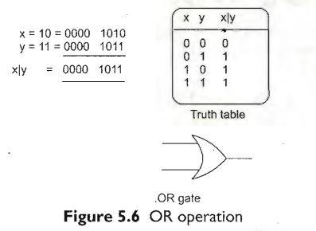
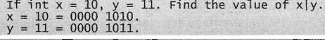
Bitwise or Operator ( I )
This operator performs or operation on the bits of the number
The symbol is I, which is called pipe symbols
From the truth table, by adding the bits, we can get x Iy = 0000 1011. This is nothing but 11 (in decimal).

Slide 55
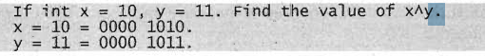
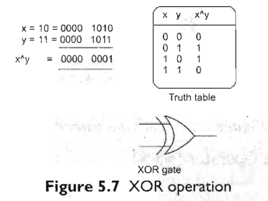
Bitwise xor Operator ( ^ )
This" operator performs exclusive or (xor) operation on the bits of the numbers.
The symbol is ^, which is called cap, carat, or circumflex symbol.
From the truth table, when odd number of 1's are there, we can get a 1 in the output. Thus, x^y =
00000001 is nothing but 1 (in decimal).

Slide 56
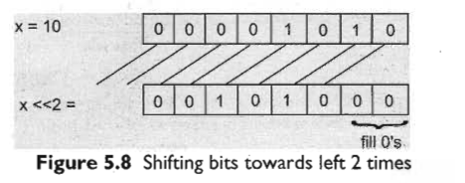
Bitwise Left Shift Operator (<)
This operator shifts the bits of the number towards left a specified number of positions.
The symbol for this operator is «, read as double less than.
If we write x«n, the meaning is to shift the bits ofx towards left n positions.
Shifting the value of x towards left 2 positions will make the leftmost 2 bits to be lost. The value of x
is 10 = 0000 1010. Now x«2 will be 0010 1000 = 40 (in decimal)

Slide 57
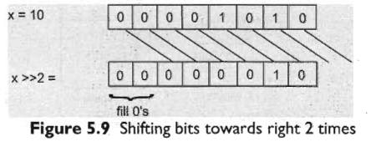
Bitwise Right Shift Operator (»)
This operator shifts the bits of the number towards right a specified number of positions.
The symbol for this operator is », read as double greater than.
If we write x»n, the meaning is to shift the bits of x towards right n positions.
Shifting the value of x towards right 2 positions will make the rightmost 2 bits to be lost. x value is
10 = 0000 1010. Now x»2 will be: 0000 0010 = 2 (in decimal)

Slide 58
Bitwise Zero Fill Right Shift Operator (>>>)
This operator also shifts the bits of the number towards right a specified number of positions.
But,it stores 0 in the sign bit.
If we apply>>> on a positive number; it gives same output as that of ».
But in case of negative numbers, the output will be
positive, since the sign bit is replaced by a O.

Slide 59
What is the difference between »and >>> ?
Both bitwise right shift operator (») and bitwise zero fill right shift operator (>>>) used to shift the bits towards right.
The difference is that >> will protect the sign bit whereas the >>> opera(or will not protect the sign bit. It always fills 0 in the sign bit.

Slide 60
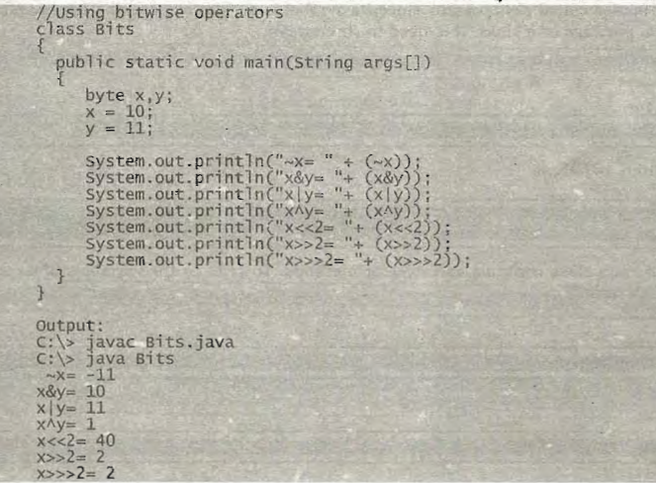
Program 1: Let us now write a program to observe the effects of various bitwise operators.

Slide 61
Ternary Operator or Conditional Operator (? : )
This operator is called ternary because it acts on 3 variables. The other name for this operator is
conditional operator, since it represents a conditional statement.
Two symbols are used for this operator ? and:

Slide 62
Member Operator ( . )
Member operator is also called dot operator since its symbol is a . (dot or period). This operator tells about member of a package or a class. It is used in three ways:
We can use. operator to refer-to the class of a package
packagename.classname;
To refer to the variables of a class, we can use this operator
classname.variablename;
To refer the method of a class , we can use this operator
classname.methodname

Slide 63
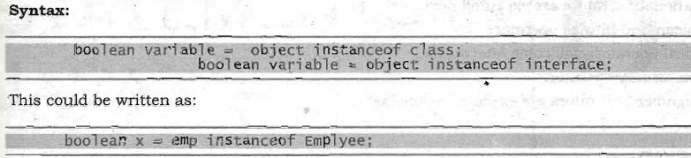
Instanceof Operator
This operator is used to test if an object belongs to a class or not

Slide 64
New Operator
new operator is often used to create objects to classes. We know that objects are created on heap memory by JVM, dynamically (at runtime).

Slide 65
Cast Operator
Cast operator is used to convert one datatype into another datatype. This operator can be used by writing datatype inside simple braces

Slide 66
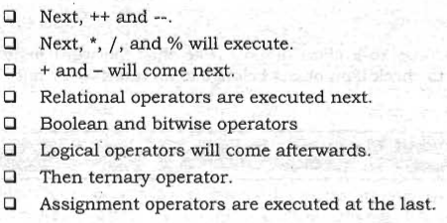
Priority of Operators
When several operators are used in a statement, it is important to know which operator will execute first and which will come next

Slide 67
Unit 6: Control statement in java
Notes:
67

Slide 68
statement
Java statement is the smallest unit that is complete instruction in itself.
Statements in Java generally contain expressins and end with a semi-colon
o Sequential statements: These are the statements which are executed 'one by one.
o Control statements: These are the statements that are executed randomly and repeatedly.

Slide 69
control statements?
Control statements are the statements which alter the flow of execution and provide better control to the programmer on the flow of execution.
They are useful to write better and complex programs
The following control statements are available In Java:
o if ...else statement
o do...while loop
o while loop
0- for loop
o for-each loop
o switch statement
o break statement
o continue statement

Slide 70
if...else statement
This statement is used to perform a task depending on whether a given condition is true or false.
if (condition) {
// statements1 (executed if condition is true)
} else {
// statements2 (executed if condition is false)
}

Slide 71
do...while Loop
This loop is used when there is a need to repeatedly execute a group of statements as long as condition is true.
If the condition is false, the repetition will be stopped and the flow of execution comes out of do...while loop.
syntax
do {
// statements
} while (condition);

Slide 72
while Loop
The functioning of this loop is also similar to do..while loop. This loop repeats a group of
statements as long as a condition is true" Once the condition is false, the loop is terminated.
Syntax:
while (condition) {
// statements
}

Slide 73
for Loop
The for loop is also same as do...while or while loop, but it is more compact syntactically.
The for loop executes a group of statements as long as a condition is true
expression1 (initialization) is executed only once.
expression2 (condition) is evaluated before each iteration.
expression3 (modification) is executed after each iteration.
Syntax:
for (initialization; condition; modification) {
// statements
}

Slide 74
Nested for Loops
We can write a for loop within another for loop.' Such loops are called nested loops
for (int i = 1; i <= 3; i++) { // Outer loop
// statements1
for (int j = 1; j <= 4; j++) { // Inner loop
// statements2
}
}

Slide 75
for-each loop
This loop is specifically designed to handle the elements of a collection.
Collection represents a group of elements
Syntax:
for (dataType var : collection) {
// statements (var represents each element)
}

Slide 76
switch Statement
When there are several options and we have to choose only one option from the available ones, we can use switch statement.
switch (variable) {
case value1:
// statements1
break;
case value2:
// statements2
break;
default:
// default statements
}

Slide 77
break Statement
The break statement can be used in 3 ways:
break is used inside a loop to come out of it.
break is used inside the switch block to come out of the switch block.
break can be used in nested blocks to go to the end of a block. Nested blocks represent a block written within another block
break statement is crucial to prevent fall-through.
label: {
// Block of code
break label; // Exits the block labeled "label"
}

Slide 78
continue Statement
continue is used inside a loop to repeat the next iteration of the loop.
When continue is executed, subsequent statements in the loop are not executed and control of execution goes back to the next repetition of the loop.
Syntax:
continue:
The continue statement can be used along with a label, like break statement as:
continue label; // here label represents name of loop

Slide 79
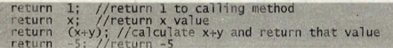
Return statement
return statement is used in a method to come out of it to the calling method

Slide 80
System.exit()
Terminates the Java Virtual Machine (JVM), ending the program.
System.exit(0): Normal termination.
System.exit(1): Termination due to an error.

Slide 81
Unit 7: Input and output
Notes:
81

Slide 82
Accepting Input from the Keyboard
A stream is required to accept input from the keyboard.
there are two types of streams:
input streams and output streams. Input streams are those streams which receive or read data coming from some other place.
Output streams are those streams which send or write data to some other place.

Slide 83
System.in: This represents InputStream object, which by default represents standard input device, i.e. keyboard.
System.out: This represents PrintStream object, which by default represents standard output device, i.e. monitor.
System.err: This field also represents PrintStream object, which by default represents monitor.

Slide 84
What is the difference between System.out and System.err ?
System.out and System.errboth represent the monitor by defaultand hence can be used to send data or results to the monitor.
But System.out is used to display normal messages and results whereas System.erris used to display error messages.

Slide 85
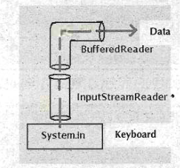
System.in (keyboard) is an InputStream, but it cannot directly read data in a user-friendly way.
To read properly, we need to connect it to other input stream classes

Slide 86
Steps
Connect Keyboard to InputStreamReader
InputStreamReader obj = new InputStreamReader(System.in);
Connect InputStreamReader to BufferedReader
BufferedReader br = new BufferedReader(obj);
Shortcut (Combine both steps in one line)
BufferedReader br = new BufferedReader(new InputStreamReader(System.in));
Now br can be used to read data from the keyboard.

Slide 87
Aaccepting a Single Character from the keyboard
Create a BufferedReader class object (br).
Then, read a single characterfrom the keyboard using read() method as:
Char ch = br.read()
It return ASCII code so typecast it
char ch = (char)br.read()

Slide 88
Accepting a String from Keyboard
readLine() method is called using BufferedReader object (br):
String str = br.readline();

Slide 89
accepting an Integer ( Value from the Keyboard)
Read input as String (using readLine())
String str = br.readLine();
readLine() always returns input as a String.
Convert String to Integer (using Integer.parseInt())
int n = Integer.parseInt(str);
Converts the string value into an integer.
Example: if user enters "25", it becomes 25 (int).
Shortcut (combine steps in one line)
int n = Integer.parseInt(br.readLine());

Slide 90
Important Notes
Integer.parseInt() is a static method of the Integer class, so it is called using the class name (Integer.parseInt()), not through an object.
Why not casting?
Casting only works between primitive types (e.g., int ↔ float) or between related class types.
String is a class, and int is a primitive data type → they are incompatible for casting.
Hence, we must use methods like Integer.parseInt() for conversion.

Slide 91
Accepting a float Value from Keyboard
Just like an integer value, we can also accept a floatvalue in the following way:
float n = Float.parseFloat(br.readLine());

Slide 92
Accepting aDouble Value/
We can accept a double value from the keyboard with the help of the following statement.
double n = Double.parseDouble(br.reaLine());

Slide 93
Accepting Other Types ofValues
we can write different statements to accept many other data types from the keyboard as follows:
to accept a byte value;
byte n = Byte.parseByte(br.readLine());
to accept a short value
short n = Short.parseByte(br.readline());
to accept a long value
long n = Long.parseLong(br.readline());
to accept a Boolean
boolean = Boolean.parseBoolean(br.readLine());

Slide 94
Accepting Different Types of Inputs in a Line

Slide 96
Reading Input with java.util.Scanner Class
We can use Scanner class of java.util package to read input from the keyboard or a text file.
next(): Reads a string.
nextByte(): Reads a byte.
nextInt(): Reads an integer.
nextFloat(): Reads a float.
nextLong(): Reads a long.
nextDouble(): Reads a double.
import java.util.Scanner;
Scanner sc = new Scanner(System.in);
int id = sc.nextInt();
String name = sc.next();
double salary = sc.nextDouble();

Slide 99
Displaying Output with System.out.printf()
Similar to printf() in C.
System.out.printf("Salary= %f%n", sal);
Format characters:
%s: string
%c: char
%d: decimal integer
%f: float number
%o: octal number
%b, %B: boolean value
%x, %X: hexadecimal number
%e, %E: number in scientific notation
%n: new line character

Slide 100
Displaying Formatted Output with String.format()
String str = String.format("i=%d%ns=%s%nch=%c", i, s, ch);
System.out.println(str);

Slide 101
Unit 8: Arrays
Notes:
101

Slide 102
What are Arrays
Arrays are used to store a collection of elements of the same data type.
They replace multiple individual variables with a single variable that represents the entire group.

Slide 103
On which memory, arrays are created in Java?
Arrays are created on dynamic memory by JVM. There is no question of static memory in Java; every thing (variable, array, object etc.) is created on dynamic memory only.

Slide 104
Types of Arrays
Single Dimensional Arrays (1D Arrays): Represent a row or column of elements.
Multi-Dimensional Arrays (2D, 3D,... Arrays): Combinations of single-dimensional arrays (e.g., a 2D array is an array of 1D arrays).

Slide 105
Single Dimensional Arrays (1D array)
A one dimensional (ID) or single dimensional array represents a row or a column of elements.

Slide 106
Creating a Single Dimensional Array
Declaration and Initialization:
int marks[] = {50, 60, 55, 67, 70}; // Direct initialization
Declaration and Memory Allocation:
int marks[] = new int[5]; // Allocates memory for 5 integers
marks[0] = 50; // Assigning values later

Slide 107
Multi Dimensional Arrays (2D arrays)
Declaration and Memory Allocation:
int marks[][] = new int[3][5]; // 3 rows, 5 columns
marks[0][0] = 50; // Assigning values later
Declaration and Initialization:
int marks[][] = {
{50, 60, 55, 67, 70},
{62, 65, 70, 70, 81},
{72, 66, 77, 80, 69}
};

Slide 108
Multi Dimensional Arrays (3D arrays)
Used to represent groups within groups (e.g., department-wise student marks).
int[][][] marks = {
{ {/*Marks of student 1 in department 1*/},
{/*Marks of student 2 in department 1*/}
},
{ {/*Marks of student 1 in department 2*/},
{/*Marks of student 2 in department 2*/}
},
{ {/*Marks of student 1 in department 3*/},
{/*Marks of student 2 in department 3*/}
}
};

Slide 109
Accessing Array Elements
Elements are accessed using their index (position) within the array.
Array indices start from 0.
For a 1D array marks, marks[0] refers to the first element, marks[1] to the second, and so on.
For a 2D array marks, marks[i][j] refers to the element at row i and column j.

Slide 110
Array Length
The length property returns the size of the array (number of elements it can hold).
For multi-dimensional arrays, length gives the number of rows.
int[] arr = new int[10];
int size = arr.length; // size will be 10

Slide 111
Command Line Arguments
Command line arguments are passed to the main() method as a String[] args array.
Arguments are passed when running the program from the command line.
args[0] contains the first argument, args[1] the second, and so on.
Public static void main(string args[])

Slide 114
Unit 9: Strings
Notes:
114

Slide 115
What is a String?
A string represents a group of characters.
In Java, a string is an object of the String class.
Unlike C/C++, it is not an array of characters.
The String class is part of the java.lang package and contains useful methods for working with text.
Example: String s = "Hello, world!";

Slide 116
The String Class
Even though String is a class, it's used so often that it can be treated like a data type.
All classes in Java can be considered "user-defined" data types.

Slide 117
Creating Strings
There are three main ways to create a string:
Using a string literal:
String s1 = "Java";
Creates the string object in the String Pool (a special memory area).
If another string with the same value is created, a new object is not made; the new reference points to the existing one.
Using the new keyword:
String s2 = new String("Java");
Creates the string object in the Heap memory.
A separate, new object is created every time this syntax is used, even if the value is the same.
As a character array:
char[] ch = {'J', 'a', 'v', 'a'};
String s3 = new String(ch);

Slide 118
String vs. StringBuilder vs. StringBuffer
String: Immutable (cannot be changed once created). Any modification creates a new String object.
StringBuilder & StringBuffer: Mutable (can be changed). Used for dynamic string operations like appending or deleting.
Key Difference:
StringBuffer is thread-safe (synchronized), meaning it is suitable for multi-threaded environments. It is slower due to synchronization.
StringBuilder is not thread-safe. It is faster and is the preferred choice for single-threaded applications.

Slide 119
String Class Methods

Slide 120
String Class Methods
1. Concatenation
concat(String s) → Joins two strings and returns a new string. Example: "Hydera".concat("bad") → "Hyderabad".
Operator + can also be used for concatenation. Example: s1 + s2 + s3.
2. Length & Character Access
int length() → Returns number of characters.
char charAt(int i) → Returns character at index i.

Slide 121
3. Comparison
int compareTo(String s) →
0 if equal
Positive if greater
Negative if smaller (dictionary order, case-sensitive).
int compareToIgnoreCase(String s) → Same as above but ignores case.
boolean equals(String s) → True if equal (case-sensitive).
boolean equalsIgnoreCase(String s) → True if equal (case-insensitive).

Slide 122
Checking Start/End
boolean startsWith(String s) → True if string starts with s.
boolean endsWith(String s) → True if string ends with s.
Searching
int indexOf(String s) → First occurrence index of substring s. Returns -1 if not found.
int lastIndexOf(String s) → Last occurrence index of substring s. Returns -1 if not found.

Slide 123
6. Replacing
String replace(char c1, char c2) → Replaces all c1 with c2. Example: "Hello".replace('l', 'x') → "Hexxo".
7. Substring
substring(int i) → Extracts substring from index i to end.
substring(int i1, int i2) → Extracts substring from i1 to i2-1.

Slide 124
7. Substring
substring(int i) → Extracts substring from index i to end.
substring(int i1, int i2) → Extracts substring from i1 to i2-1.
9. Trimming
trim() → Removes leading and trailing spaces (not middle spaces).
10. Character Array & Splitting
void getChars(int i1, int i2, char[] arr, int i3) → Copies substring into character array.
String[] split(String delimiter) → Splits string based on delimiter into an array. Example: "a,b,c".split(",") → ["a", "b", "c"].

Slide 125
String Comparison
• Relational operators (>, <, >=, <=, ==) cannot be used to compare strings.
• Instead, use String methods:
compareTo(String s) → Compares strings lexicographically.
Returns 0 if equal
Positive if greater
Negative if smaller
equals(String s) → Checks if two strings are exactly equal (case-sensitive).
equalsIgnoreCase(String s) → Checks equality ignoring case.
compareToIgnoreCase(String s) → Compares lexicographically ignoring case.

Slide 126
Immutability of Strings
Objects are of two types:
Mutable → Contents can be changed.
Immutable → Contents cannot be changed once created.
Strings in Java are immutable:
Once a String object is created, its value cannot be modified.
Any operation (like concat, replace, substring) creates a new String object instead of modifying the original.
Example:
String s1 = "Hello";
s1.concat(" World");
System.out.println(s1); // Output: Hello
The original s1 is unchanged.
A new string "Hello World" is created, but not assigned.

Slide 127
Unit 10: StringBuffer and string builder
Notes:
127

Slide 128
String vs StringBuffer
• String (Immutable)
Once created, cannot be modified.
Any change creates a new object.
No direct methods to modify contents.
• StringBuffer (Mutable)
Contents can be modified.
Provides methods to manipulate data directly.
More efficient for repeated modifications.
Besides String, many classes in Java are also immutable:
Wrapper Classes: Character, Byte, Integer, Float, Double, Long
Other Immutable Classes: Class, BigInteger, BigDecimal

Slide 129
Creating StringBuffer Objects
1. Direct Initialization
StringBuffer sb = new StringBuffer("Hello");
Creates a StringBuffer object with the string "Hello

Slide 130
Creating StringBuffer Objects
2. Empty Constructor (Default Capacity)
StringBuffer sb = new StringBuffer();
Creates an empty StringBuffer.
Default capacity = 16 characters.
Expands automatically if needed.

Slide 131
Creating StringBuffer Objects
3 .With Defined Capacity
StringBuffer sb = new StringBuffer(50);
Creates an empty StringBuffer with capacity = 50.
Can still expand beyond 50 characters.

Slide 132
Adding Data into StringBuffer
Use methods to insert or append data:
sb.append("Hello"); // Adds "Hello" to sb
sb.insert(0, "Hi "); // Inserts "Hi " at index 0
Since StringBuffer is mutable, these changes are made inside the same object, not a new one

Slide 133
StringBuffer Methods (1/4)
1. append(x)
Adds data (boolean, int, char, String, etc.) at the end of StringBuffer.
Example:
StringBuffer sb = new StringBuffer("Uni");
sb.append("versity");
// Result: "University"
2. insert(int i, x)
Inserts data at position i.
Example:
StringBuffer sb = new StringBuffer("Intelligent Person");
sb.insert(11, "young");
// Result: "Intelligentyoung Person

Slide 134
StringBuffer Methods (2/4)
3. delete(int i, int j)
Removes characters from index i to j-1.
Example:
sb.delete(0,3);
// "University" → "versity"
4. reverse()
Reverses characters in StringBuffer.
Example: "abc" → "cba"
5. toString()
Converts StringBuffer → String.
Useful to apply String methods on it.

Slide 135
StringBuffer Methods (3/4)
6. length()
Returns number of characters.
7. indexOf(String str)
Returns first occurrence index of substring.
Example: "This is a book".indexOf("is") → 2
8. lastIndexOf(String str)
Returns last occurrence index of substring.
Example: "This is a book".lastIndexOf("is") → 5

Slide 136
StringBuffer Methods (4/4)
9. replace(int i, int j, String str)
Replaces characters from i to j-1 with str.
Example:
sb.replace(0,4,"Low");
// "High cost" → "Low cost"
10. substring(int i)
Returns substring from index i to end.
Example: "New Delhi".substring(4) → "Delhi"
11. substring(int i, int j)
Returns substring from i to j-1.
Example: "New Delhi".substring(0,3) → "New"

Slide 137
Unit 11: Introduction to oops
Notes:
137

Slide 138
: Procedure-Oriented Programming (POP)
Examples: C, Pascal, Fortran
Programs divided into subtasks (functions/procedures)
Main function controls execution of other functions
Emphasis on procedures rather than data
Known as Procedure-Oriented Approach

Slide 139
Object-Oriented Programming (OOP)
Examples: C++, Java
Uses classes and objects as building blocks
A class = data + methods to perform tasks
Tasks divided into modules (classes)
Each class handles its own responsibilities
Known as Object-Oriented Approach

Slide 140
Shift from POP to OOP
POP dominated for decades
Limitations observed with growing software complexity
Industry moved towards Object-Oriented Approach
OOP offers better modularity, reusability, and maintainability

Slide 141
Problems in Procedure-Oriented Approach
Focus only on tasks, not on reusability
New tasks = writing new functions again
Code reusability is very limited
System viewed as fragments of tasks

Slide 142
Issues with Large-Scale Software in POP
Code size grows rapidly (10,000–100,000+ lines)
Programmers lose control over code
Difficult to debug, extend, or maintain
Fails in complex systems (e.g., satellite control software)

Slide 143
POP vs. Natural Human Life
POP considered unnatural way of programming
Example: talking naturally vs. imitating someone else
Programming becomes easy if modeled on real life
Human analogy: friends interact, enemies don’t → like objects in code

Slide 144
Rise of Object-Oriented Approach (OOP)
Need for modular, reusable, and manageable code
Built around classes (reusable modules)
Suitable for large and complex applications
Based on single root concept: Object
Everything in real life = object (humans, animals, things)
Programming with this concept = Object-Oriented Programming System (OOPS)

Slide 145
Slide 8: Features of Object-Oriented Programming System (OOPS)
Class/Object – Basic building blocks of OOP
Encapsulation – Wrapping data & methods together
Abstraction – Hiding implementation details, showing only essentials
Inheritance – Reusing code by creating new classes from existing ones
Polymorphism – Same function/method behaves differently in different contexts

Slide 146
Slide 9: Object in OOP
An object is anything that physically exists in the real world
Examples: Table, Car, Dog, Person
Not objects: thoughts, ideas, imagination (no physical existence)
Every object has:
Properties → represented as variables (e.g., name, age)
Actions → represented as methods (e.g., talking, walking)

Slide 147
Slide 10: Class in OOP
A class is a model or blueprint for creating objects
Class itself does not exist physically
Objects are instances of a class
Example:
Class = Person
Objects = Raju, Ravi, Sita

Slide 148
Slide 11: Class vs. Object
Class = Blueprint (e.g., “Shirt design”, “Flower”, “Car”)
Object = Real instance (e.g., “Stitched Shirt”, “Rose”, “Maruti”)
Class can exist without objects
Object cannot exist without a class

Slide 149
Slide 12: Real-Life Analogies
Tailor & Shirt:
Design/plan = Class
Stitched shirts = Objects
Cloth = Memory (JVM allocates heap memory for objects)
Examples:
Table, Chair, Cot = Objects of class Furniture
Maruti, Santro, Benz = Objects of class Car
Red, Blue, Green = Objects of class Color

Slide 150
Slide 13: Creating Classes in Java
A class is created using the keyword class
A class defines:
Properties (variables)
Actions (methods)
Example: Person class
class Person {
private String name;
private int age;
public void talk() {
System.out.println("Hello, I am " + name);
}
}

Slide 151
Slide 14: Creating Objects in Java
Objects are created using the new keyword
Example:
Person raju = new Person();
Person sita = new Person();
Class code → stored in JVM’s method area
Objects → stored in heap memory

Slide 152
Slide 15: Accessing Methods & Encapsulation
Variables declared as private → cannot be accessed directly
Public methods allow controlled access
Example:
raju.talk();
Ensures data security & encapsulation

Slide 153
Slide 16: Abstraction in OOP
Definition: Hiding unnecessary details and exposing only essential information
User interacts only with relevant data/methods
Provides a clear and simple view of the system

Slide 154
Slide 17: Real-Life Examples of Abstraction
Car:
Driver knows how to drive → not engine design
Engine & parts hidden under the hood
Bank System:
Clerk sees: Account no., Name, Balance
Manager sees: Staff salaries, Loans, Profits

Slide 155
Slide 18: Advantages of Abstraction
Simplifies usage → user sees only what is needed
Different users get different views of the same data
Prevents confusion with unnecessary details
Supports data security & controlled access

Slide 156
Slide 19: Inheritance in OOP
Definition: Creating new classes from existing ones
New class acquires variables + methods of existing class
Example from nature: Children inherit qualities of parents
Superclass (Parent Class) → Original class
Subclass (Child Class) → Derived class

Slide 157
Slide 20: Advantages of Inheritance
Code Reusability → avoid rewriting same code
Easy creation of new classes (built on existing ones)
Better code management through hierarchy & modularity

Slide 158
Slide 21: Example – Inheritance in Java
class A {
protected int a, b;
void method1() {
System.out.println("From Class A");
}
}
class B extends A {
int c;
void method2() {
System.out.println("From Class B");
}
}
Class B inherits variables a, b and method method1() from Class A
Class B also has its own variable c and method method2()

Slide 159
Slide 22: Polymorphism in OOP
Meaning: “Poly” = many, “Morphos” = forms → many forms
Ability of a method/variable to behave differently based on object type
A single method call can perform different tasks
Provides flexibility & simplicity in programming

Slide 160
Example – Polymorphism in Java
class One {
void calculate() {
System.out.println("Square");
}
}
class Two extends One {
void calculate() {
System.out.println("Cube");
}
}
One ref;
ref = new One();
ref.calculate(); // Square
ref = new Two();
ref.calculate(); // Cube
Same method call → different outputs

Slide 161
Advantages of Polymorphism
Code Reusability – same interface, different implementation
Flexibility – write general methods, use them in many contexts
Extensibility – new classes can define their own behavior easily

Slide 169
Unit 12: Classes and objects
Notes:
169

Slide 170
Classes and Objects – Introduction
A class is a blueprint for creating objects.
Class = variables (properties) + methods (actions).
Objects are created from classes and hold instance variables.
Example: Person class → properties: name, age; actions: talk, walk.

Slide 171
Declaring a Class
Keyword: class to define a class.
Inside class: declare instance variables + methods.
Example:
class Person {
String name;
int age;
void talk() {
System.out.println("I am Raju, age 22");
}
}

Slide 172
Object Creation
Objects are created using the new operator.
Syntax:
Person Raju = new Person();
Here:
Person → class name (data type).
Raju → reference variable.
new Person() → creates object in heap.

Slide 173
JVM Memory Organization
Class code + methods → stored in method area.
Objects → stored in heap memory.
JVM assigns a unique reference number (hash code).
Reference points to instance variables; methods remain in method area.

Slide 174
Hash Code
Hash code = unique identification number for object.
Created based on object’s memory location.
Example:
Employee e1 = new Employee();
System.out.println(e1.hashCode());
Each object (except Strings) has a unique hash code

Slide 175
Default Values of Instance Variables
If not initialized, compiler assigns default values:
int → 0
float → 0.0
boolean → false
String → null
Initialization is programmer’s responsibility.

Slide 176
Access Specifiers
Control accessibility of class members.
Four types:
private → accessible only within class.
public → accessible everywhere.
protected → accessible within package & subclasses.
default → accessible within package (no keyword).
Common use: private variables, public methods.

Slide 177
Initialization of Instance Variables
Ways to initialize variables:
In another class (e.g., Demo).
Directly inside class.
Using constructors.
With constants (final).

Slide 178
Constructors
Special method to initialize instance variables.
Same name as class.
Called automatically at object creation.
No return type (not even void).
Types:
Default constructor (no parameters).
Parameterized constructor (takes input values).

Slide 179
Constructor Examples
Default constructor:
Person() {
name = "Raju"; age = 22;
}
Parameterized constructor:
Person(String n, int a) {
name = n; age = a;
}

Slide 180
Constructor Overloading
Writing multiple constructors with same name but different parameters.
Allows flexibility in object creation.
Example:
Person() → default.
Person(String n, int a) → parameterized.

Slide 181
Difference – Method vs Constructor
Constructor:
No return type.
Same name as class.
Called at object creation.
Method:
Has return type (or void).
Name can be anything.
Called explicitly by object.

Slide 182
Using Methods in Classes
Methods operate on instance variables.
Example:
accept() → take input.
check() → process data (e.g., check age).
Methods increase code reusability.

Slide 183
: Example – Command Line Arguments
Initialize object using input from command line.
Example:
Person p = new Person(args[0], Integer.parseInt(args[1]));
Allows dynamic object initialization.

Slide 186
Unit 13: Methods in java
Notes:
186

Slide 187
Methods in Java – Introduction
A method = group of statements performing a task
Tasks may include: calculation, processing data, generating reports
Methods have 2 parts:
Method header / prototype
Method body
Example: double sqrt(double num) → returns square root

Slide 188
Method Prototype
Format: returnType methodName(parameters)
Return type = data type of result (e.g., int, double, void)
Method name = identifier for method
Parameters = variables receiving data from outside
Examples:
void sum() – no parameters, no return
long factorial(int x) – returns factorial value
int[][] matrixSum(int a[][], int b[][]) – returns sum of two matrices

Slide 189
Method Body
Contains logic of the task
Written inside { } after prototype
May include variables, loops, conditions
Use return statement to return values
A method can only return one value
Example:
return x; // valid
return x, y; // invalid

Slide 190
Instance Methods
Operate on instance variables of the class
Called using: objectName.methodName()
Example:
Sample s = new Sample();
s.sum();
Can return values to calling method
Useful for object-specific operations

Slide 191
Static Methods
Declared using keyword static
Do not operate on instance variables
Called using: ClassName.methodName()
Example:
Sample.sum(10, 20);
Instance variables not accessible in static methods
Can access static variables (class variables)

Slide 192
Static vs Instance Variables
Instance variable:
Separate copy for each object
Stored in heap memory
Static variable:
Single copy shared by all objects
Stored in method area
Change in static variable affects all objects

Slide 193
Execution Order in JVM
JVM execution order:
Static block
Static methods (including main)
Object creation
Instance methods
Static block executes before main()
Possible to run a program without main() using static block

Slide 194
Local Variables
Declared inside a method/constructor
Scope = limited to that block
Cannot be accessed outside the method
Instance variables = accessible anywhere in the class
Example:
void modify() {
int a = 10; // local variable
}

Slide 195
The this Keyword
Refers to current object of the class
Used to:
Differentiate local & instance variables
Call current class constructor (this())
Call current object’s methods/variables
Example:
this.x = x;
this.display();

Slide 196
Accessor & Mutator Methods
Accessor (getter): reads instance variables
Example: getName()
Mutator (setter): modifies instance variables
Example: setName(String n)
Improves encapsulation
Commonly used in JavaBeans

Slide 197
Passing Data to Methods
Primitive types: passed by value (copy passed)
Modifications inside method do not affect original
Objects & arrays: also passed by value, but reference copy is used
Changes in object data reflect outside
Arrays can be passed and returned from methods

Slide 198
Recursion
A method calling itself
Used for repetitive tasks
Example: Factorial
Iterative: num * (num-1) * ...
Recursive:
if(num == 1) return 1;
else return num * factorial(num-1);

Slide 199
Factory Methods
Special static methods that create and return objects
Alternative to constructors
Example:
NumberFormat nf = NumberFormat.getNumberInstance();
Advantages:
Flexibility with parameters
Replaces multiple constructors

Slide 200
Ways to Create Objects in Java
Using new operator → Employee e = new Employee();
Using factory methods → NumberFormat.getNumberInstance();
Using newInstance() method of Class
Cloning an existing object

Slide 204
Unit 14: Relationship between objects
Notes:
204

Slide 205
Relationship Between Objects
Objects of different classes can be related
Relationship allows one object to access/use members of another
Useful for passing data between objects
Supports chained processing of data
Three ways to relate objects:
Using References
Using Inner Classes
Using Inheritance (next chapter)

Slide 206
Relating Objects Using References
Create reference of one class inside another
Reference variable points to other object’s members
Example:
Class One has reference of Class Two
Can call Class Two’s methods and variables directly
Steps:
Pass reference of Class Two object to Class One
Store reference in Class One constructor
Use reference to access Class Two members

Slide 207
Example – Reference Relationship
obj2 of Class Two passed to obj1 of Class One
Reference stored in variable t of Class One
t can access:
Class Two’s methods → t.display()
Class Two’s variables → t.y
Diagram: obj1 → obj2 (relationship in memory)

Slide 208
Multi-Class Relationship (Object Graph)
Objects can be linked across multiple classes
Example:
Class One → Class Two → Class Three
Object references passed in chain
One object can call methods of another via references
Object Graph = diagram showing relationship of objects in memory

Slide 209
Inner Class Concept
Inner class = class written inside another class
Acts as a safety mechanism (hidden from outside classes)
Outer class controls access to inner class
Private inner class:
Cannot be instantiated outside outer class
Provides security for sensitive code
Used when entire class code should be restricted

Slide 210
Example – Bank Account with Inner Class
BankAcct = outer class (stores balance, rate)
Interest = private inner class (calculates interest)
Access to inner class only through outer class method (contact)
Outer class acts as firewall for authentication
Inner class object contains hidden reference this$0 → points to outer class

Slide 211
Key Points about Inner Classes
Defined inside another class
Hidden from outside classes
Inner class object created only inside its outer class
Can access outer class members directly
Separate memory locations for outer & inner class objects
Extra hidden field: this$0 (links inner → outer class)
Outer class members → OuterClass.this.member
Inner class members → this.member

Slide 212
Anonymous Inner Class
Inner class without a name
Only one object created
Common in GUI programming (e.g., ActionListener)
Used to pass class code directly into method parameter
Replaces writing a separate implementation class
Example: button click → terminate application using anonymous inner class

Slide 213
Characteristics of Anonymous Inner Class
No class name written in outer class
Object created only once
Code directly inside method parameter
Common in event handling (e.g., addActionListener())
More compact but may reduce readability

Slide 215
Unit 15: Inheritance
Notes:
215

Slide 216
Inheritance – Introduction
Inheritance = creating new classes from existing ones
New class (subclass) acquires features of existing class (superclass)
Promotes reusability of code
Increases productivity in software development

Slide 217
Example – Teacher & Student Classes
Teacher class written & stored in central database
Student class initially created separately (75% similar code)
Using extends keyword, Student class can reuse Teacher’s code
Subclass contains copy of superclass within it

Slide 218
Superclass & Subclass
Superclass → Original class (e.g., Teacher)
Subclass → Derived class (e.g., Student)
Syntax:
class Subclass extends Superclass
Subclass has access to all superclass members + its own

Slide 219
Advantages of Inheritance
Reuse existing code without rewriting
Reduces code duplication
Faster development & higher productivity
Easier maintenance and extension

Slide 220
The super Keyword
Used to access superclass members in subclass
Cases where super is used:
Access superclass variables
Call superclass methods
Call superclass constructors
Default constructor is automatically called

Slide 221
Constructors in Inheritance
Subclass constructor first calls superclass constructor
If superclass has default constructor, it’s auto-called
If superclass has parameterized constructor, use super() explicitly
super() must be the first statement in subclass constructor

Slide 222
The protected Specifier
private members → Not accessible in subclass
protected → Allows direct access in subclass
Behaves like public for subclasses
Example: Shape → Square → Rectangle (area calculation using protected members)

Slide 223
Types of Inheritance
Single Inheritance
One superclass → One or more subclasses
Supported in Java
Multiple Inheritance
One subclass → Derived from multiple superclasses
Not supported directly in Java (to avoid ambiguity)
Achieved using interfaces

Slide 224
Why Multiple Inheritance is Not in Java
Leads to confusion (same member in multiple superclasses)
Example: Class A & B both have variable x → ambiguity in subclass C
Alternatives in Java:
Interfaces (multiple inheritance of type)
Repeated single inheritance

Slide 229
Unit 16: Polymorphism
Notes:
229

Slide 230
Polymorphism in Java
Derived from Greek: poly = many, morphos = forms
Ability of variables, objects, or methods to exist in multiple forms
Provides flexibility in programming
Same variable/method can perform different tasks

Slide 231
Polymorphism with Variables
Compiler decides result data type depending on operands
Example: a+b → int if both are int, float if one is float
Automatic type conversion = Coercion
Explicit type change using cast = Conversion

Slide 232
Key Definitions
Coercion: Automatic conversion between data types by compiler
Conversion: Explicit change in data type using cast operator
Example: float a cast to int → different forms of same variable

Slide 233
Polymorphism with Methods
Same method name can perform different tasks
Achieved through multiple method bodies
Method binding happens at:
Compile time → Static Polymorphism
Runtime → Dynamic Polymorphism

Slide 234
Dynamic Polymorphism
Binding occurs at runtime (dynamic binding)
JVM decides which method to call (not compiler)
Uses method signature (name + parameters) to differentiate
Example: Method Overloading & Overriding with objects

Slide 235
Method Signature
Consists of: Method name + Parameter list
JVM differentiates methods with same name but different signatures
Differences may be due to:
Number of parameters
Order of parameters
Data type of parameters

Slide 236
Method Overloading
Writing multiple methods in same class with same name but different signatures
Example: add(int, int) vs add(int, float)
JVM binds correct method dynamically at runtime
Called code refinement (enhancing functionality)

Slide 237
Method Overriding
Writing same method (name + signature) in superclass & subclass
Subclass method replaces superclass method
JVM decides based on object reference type
Called code replacement
Example: calculate() in superclass (square) overridden in subclass (square root)

Slide 238
Overloading vs Overriding
Overloading:
Same name, different signatures (parameters)
Occurs in same class
Enhances functionality (refinement)
Overriding:
Same name, same signature in super & sub classes
Replaces functionality (replacement)
Depends on object type at runtime

Slide 239
Static Polymorphism
Occurs at compile time (static binding)
Examples:
Overloading/Overriding with static methods
Overloading private methods
Overloading final methods
Compiler knows method before execution

Slide 240
Polymorphism with Private & Final Methods
Private methods:
Not inherited, cannot be overridden
Can only be overloaded
Final methods:
Cannot be overridden
Improve performance via inline expansion
Ensure method safety from modification

Slide 241
Final Keyword
Used to declare:
Constants → final double PI = 3.14159;
Final classes → Prevent inheritance
Final methods → Prevent overriding
Private methods act similar to final methods

Slide 242
Dynamic vs Static Polymorphism
Dynamic (Runtime):
JVM decides method at runtime
Examples: Overloading & Overriding with instance methods
Static (Compile-time):
Compiler decides method at compile time

Slide 243
Example – Electricity Bill
Commercial class: calculateBill() → Rs. 5.00/unit
Domestic class: Overrides calculateBill() → Rs. 2.50/unit
Demonstrates method overriding in real-world scenario

Slide 245
Unit 17: Type casting
Notes:
245

Slide 246
Type Casting in Java
Converting one data type into another = Type Casting
Also called Casting
Achieved using cast operator (datatype) before variable/method
Ensures uniformity in assignment

Slide 247
Data Types in Java
Primitive (Fundamental) → Single values (e.g., int, char, boolean)
Referenced (Advanced) → Collections/objects (e.g., arrays, classes)
Primitive = no methods
Referenced = methods available
Cannot directly cast primitive ↔ reference (use Wrapper classes)

Slide 248
Casting Primitive Data Types
Conversion between primitive data types possible
Two types:
Widening (lower → higher type)
Narrowing (higher → lower type)
Boolean cannot be converted to other types

Slide 249
Widening (Primitive)
Converting lower type → higher type
Safe (no data loss)
Example:
char ch = 'A'; int num = ch; // num = 65
int x = 9500; float sal = x; // sal = 9500.0
Compiler does it automatically → Implicit Casting

Slide 250
Narrowing (Primitive)
Converting higher type → lower type
Not safe (data loss possible)
Example:
int n = 66; char ch = (char)n; // ch = 'B'
double d = 12.6789; int n = (int)d; // n = 12
Requires programmer’s cast → Explicit Casting

Slide 251
Casting Referenced Data Types
Classes (objects) can also be casted
Must have inheritance relationship
Example:
College ↔ University ↔ Department
Invalid: Dog ↔ Horse (no relation)
Two types: Generalization (Upcasting), Specialization (Downcasting)

Slide 252
Generalization (Upcasting)
Subclass → Superclass
Scope widens (becomes general)
Safe, compiler does implicit casting
Example: Lemon → Citrus → Fruit
Implicit Casting

Slide 253
Specialization (Downcasting)
Superclass → Subclass
Scope narrows (becomes specific)
Not safe → requires explicit cast
Compiler forces programmer to cast
Example: Fruit → Lemon
Explicit Casting

Slide 254
Widening in Reference Types
Superclass reference → Subclass object
Example:
One o = new Two();
Access: only superclass methods
Overridden methods in subclass still work
50% functionality available

Slide 255
Narrowing in Reference Types
Subclass reference → Superclass object
Not safe → often 0% functionality
Example:
Two t = (Two) new One(); // Error
Solution: Create Subclass object and cast
Provides 100% functionality

Slide 256
Object Class
Superclass of all classes in Java (java.lang)
Defines universal methods:
equals() → compares objects
getClass() → returns class name
clone() → copies objects
toString(), notify(), etc.
Object reference can store any class object

Slide 257
equals() Method
By default → compares references
With Strings & Wrapper classes → compares contents
Example:
MyClass objects → compares references
Integer objects → compares values

Slide 258
getClass() Method
Returns the class name of an object
Example:
obj.getClass().getName();
Useful for reflection/debugging

Slide 259
Cloning
Copy of an object (bitwise copy)
Types:
Shallow cloning → changes affect both objects
Deep cloning → changes do not affect original
Advantage: Faster than re-processing new object
Implemented using clone() method

Slide 260
Steps for Cloning
Class must implement Cloneable interface
Use clone() method of Object class
If not → throws CloneNotSupportedException
Example: Employee class clone program

Slide 261
Marking Interfaces
Interfaces without methods = Marking Interfaces
Example:
Cloneable → indicates class is cloneable
Serializable → indicates class is serializable
Acts like a “tag” for special behavior

Slide 263
Unit 18: Abstract classes
Notes:
263

Slide 264
Introduction to Classes
A class is a model for creating objects.
Contains properties (variables) and actions (methods).
Anything written in a class applies to all objects.
Example: MyClass with method calculate() available to all objects.

Slide 265
Need for Abstract Classes
Sometimes objects require different tasks.
One object may need square, another square root, another cube.
Writing all methods (calculateSquare(), calculateSqrt(), etc.) in one class is inefficient.
Solution: Use abstract method (no body) in superclass.
Subclasses implement methods as required.

Slide 266
Abstract Method
A method without a body.
Written when the same method must perform different tasks.
Declared using abstract keyword.
Implemented later in subclasses

Slide 267
Abstract Class
A class containing 0 or more abstract methods.
Cannot be instantiated (no objects).
Subclasses must implement abstract methods.
Declared using abstract keyword.
Example: abstract class MyClass { abstract void calculate(); }

Slide 268
Concrete vs Abstract Methods
Concrete Method: Has a body (e.g., openTank()).
Abstract Method: No body, implementation left to subclasses (e.g., steering(), braking()).
Abstract classes can have both abstract and concrete methods

Slide 269
Example – Car Class
Abstract class Car:
Instance variable: registrationNumber.
Concrete method: openTank().
Abstract methods: steering(), braking().
Subclasses: Maruti, Santro → implement steering and braking differently

Slide 270
Using Abstract Class Reference
Objects cannot be created for abstract class.
But reference variables can be created.
Abstract reference can refer to subclass objects.
Helps enforce discipline: only superclass features accessible.

Slide 271
Example – Electricity Bill Calculation
Abstract class Plan:
Instance variable: rate.
Abstract method: getRate().
Subclasses:
CommercialPlan → rate = Rs. 5.00/unit.
DomesticPlan → rate = Rs. 2.60/unit.
Concrete subclass Calculate → uses abstract class reference to compute bills

Slide 272
Advantages of Abstract Classes
Provide flexibility in programming.
Different subclasses implement methods differently.
Encourage code reusability and maintainability.
Useful for designing frameworks and enforcing discipline.

Slide 273
Abstract vs Final
abstract → class needs subclasses (incomplete).
final → class cannot have subclasses.
Both are contradictory → cannot use together.

Slide 276
Unit 19: Interface
Notes:
276

Slide 277
What is an Interface?
Interface = specification of method prototypes
All methods are public and abstract by default
No objects can be created from an interface
Classes implement interface methods → become implementation classes

Slide 278
Importance of Interfaces
Allows multiple classes to provide their own implementations
Increases flexibility and reusability
Enables third-party vendors to provide drivers (e.g., databases, printers)
Example: Credit card analogy (card = interface, bank account = implementation class)

Slide 279
Interface & Database Example
Programmer writes interface MyInter with connect/disconnect methods
Implementation classes: OracleDB, SybaseDB, etc.
Users choose driver class depending on database
Promotes vendor independence

Slide 280
API Documentation Role
Vendors need to know methods to implement
API Document provides method descriptions
Written in HTML format
Works as reference manual for third-party developers

Slide 281
Printer Interface Example
Interface Printer with printIt() and disconnect() methods
Implementation classes: IBMPrinter, EpsonPrinter
Config file (config.txt) stores driver name
Program dynamically loads driver using Class.forName() & newInstance()

Slide 282
Multiple Inheritance Using Interfaces
Java doesn’t support multiple inheritance with classes
Interfaces allow multiple inheritance without ambiguity
Example:
Father & Mother interfaces with constant HT and method height()
Child class implements both, calculates average height

Slide 283
Abstract Class vs Interface
Abstract Class
Can have abstract + concrete methods
Declared using abstract keyword
Same team must provide subclasses
Faster (less overhead)
Interface
Only abstract methods
Declared using interface keyword
Third-party vendors can provide implementations
Slower (JVM searches implementation at runtime)

Slide 284
When to Use?
Abstract Class → When objects share common features
Interface → When different implementations are required
Example:
WholeSaler abstract class → same text books, different stationery
WholeSaler interface → different text books & stationery

Slide 288
Unit 20: Package
Notes:
288

Slide 289
Packages in Java
Organize related classes & interfaces into groups
Stored in directories (folders) called packages
Example: java.io, java.util, java.awt
A package = subdirectory of classes/interfaces

Slide 290
Need for Packages
Groups related classes/interfaces together
Prevents accidental deletion of classes
Allows classes with the same name in different packages (e.g., Date in java.util & java.sql)
Promotes reusability (like a library of books)

Slide 291
Types of Packages
Built-in Packages (Java predefined)
User-defined Packages (created by programmers)

Slide 292
Built-in Packages – java.lang
Contains core classes & interfaces
Wrapper classes (convert primitives to objects)
String, StringBuffer for strings
Thread, Runtime, System classes
Garbage collection using System.gc() or Runtime.getRuntime().gc()

Slide 293
Built-in Packages – Others
java.util → Collections (Stack, Vector, Hashtable, Arrays) & Date/Time handling
java.io → Input/Output, Streams
java.awt → GUI components, graphics
java.awt.event → Event handling (buttons, menus, etc.)
javax.swing → Extended GUI toolkit
java.net → Networking (Sockets, Client-Server)
java.applet → Applet support
java.text → DateFormat, NumberFormat
java.sql → Database connectivity

Slide 294
User-defined Packages
Programmers can create their own packages
Syntax: package packagename;
Classes must be declared public to be accessible
Example: Package pack with class Addition

Slide 295
Using User-defined Packages
Import with import pack.ClassName;
Or import pack.*; to include all classes
Compile with javac -d . ClassName.java (creates subdirectory)
Example: Using Addition & Subtraction classes from pack

Slide 296
Import Statement Differences
import pack.Addition; → Only Addition class imported
import pack.*; → All classes in pack imported
Specific import = faster compilation (less load on compiler)

Slide 297
CLASSPATH in Java
Environment variable that tells compiler where to find classes
Can be directory or JAR file
Example: set CLASSPATH=D:\sub;.
-cp option also used at runtime

Slide 298
JAR Files
Java Archive File = compressed package (like .zip)
Stores classes, images, audio, etc.
Created using jar cf pack.jar pack
View contents with jar tf pack.jar
Makes sharing & reusability easier

Slide 299
Interfaces in Packages
Interfaces can also be placed inside packages
Implementation classes must be created separately
Example: MyDate interface with showDate()
Implemented by DateImpl class

Slide 300
Sub-packages
Format: package pack1.pack2;
Example: dream.tech contains Sample class
Import with import dream.tech.Sample;
Helps organize large projects

Slide 301
Access Specifiers in Packages
private → Accessible only within class (Class scope)
public → Accessible everywhere (Global scope)
protected → Accessible in same package + subclasses
default → Accessible only within same package

Slide 302
API Documentation
API = Application Programming Interface
HTML-based documentation of classes, methods, fields
Helps programmers understand & use libraries
Created using javadoc tool
Example: javadoc -d doc Addition.java Subtraction.java

Slide 304
Unit 21: Exception handling
Notes:
304

Slide 305
Exception Handling – Introduction
Errors in Java: Compile-time, Logical, Run-time
Compile-time: syntax mistakes (e.g., missing semicolon)
Logical: wrong formula/design → wrong output
Run-time: issues like division by zero, insufficient memory
Exception = runtime error that can be handled
Errors ≠ Exceptions (errors cannot be handled)

Slide 306
Types of Errors in Java
Compile-time errors → detected by compiler
Logical errors → incorrect logic, programmer’s fault
Run-time errors → JVM/system fails during execution
Example: missing main(String args[]) causes runtime issue

Slide 307
Exceptions Overview
Exceptions = runtime errors that can be handled
Checked exceptions → verified at compile-time
Unchecked exceptions → detected at runtime by JVM
Throwable = superclass of all errors & exceptions
Exception (recoverable) vs. Error (unrecoverable)

Slide 308
Exception Hierarchy
Throwable superclass
Exception (recoverable)
Error (unrecoverable)
Exception subclasses: RuntimeException, IOException, etc.
Example: ArithmeticException, ArrayIndexOutOfBoundsException

Slide 309
Exception Handling Steps
Step 1: Identify risky statements → put in try block
Step 2: Handle exception using catch block
Step 3: Cleanup in finally block
Prevents program from abnormal termination
Protects user data & ensures resource cleanup

Slide 310
Try–Catch–Finally Example
try → code that may cause exception
catch → handles exception, displays details
finally → executes always, ensures cleanup
Example: division by zero handled with try–catch
JVM stores exception details in stack for catch block

Slide 311
Handling Multiple Exceptions
One try block → multiple catch blocks
Each catch handles specific exception type
Only one exception occurs at a time
Example: ArithmeticException & ArrayIndexOutOfBoundsException
Nested try blocks are also possible

Slide 312
Throws Clause
Used when programmer doesn’t handle checked exceptions
Declares exception in method signature → throws IOException
Compiler checks for handling/declaring checked exceptions
Example: BufferedReader.readLine() throws IOException
If not handled, program won’t compile

Slide 313
Throw Statement
Used to explicitly throw exceptions
Example: throw new NullPointerException("Error")
Useful for:
Testing exception handling in programs
Creating user-defined exceptions
Throw inside try → caught in catch

Slide 314
User-Defined Exceptions
Create custom class extending Exception
Add constructors to store error messages
Throw using throw statement
Example: MyException for insufficient bank balance
Used when built-in exceptions are insufficient

Slide 315
Re-throwing Exceptions
Catch block can re-throw exception to another method/class
Useful for passing error details up the call stack
Example: Exception caught in Class A, re-thrown to Class B
Allows central handling of exceptions

Slide 316
Types of Exceptions
Built-in Exceptions:
ArithmeticException
ArrayIndexOutOfBoundsException
StringIndexOutOfBoundsException
User-Defined Exceptions: created by programmers

Slide 321
Unit 22: Wrapper classes
Notes:
321

Slide 322
Introduction to Wrapper Classes
Many applications send/receive data over the Internet
Servers expect objects, not primitives
Wrapper classes convert primitives into objects
Collections in java.util work only with objects → wrappers required
Example: int → Integer object

Slide 323
Definition & Need
Wrapper class = class that wraps a primitive data type
Stores primitive in an object field
Needed for:
Internet communication (objects only)
Using primitives in collections (ArrayList, HashMap, etc.)

Slide 324
Wrapper Classes in Java
Defined in java.lang package
Wrapper classes:
Boolean, Character, Byte, Short, Integer, Long, Float, Double
Each corresponds to a primitive data type
Example: Character ch = new Character('A');

Slide 325
Number Class
Abstract superclass for: Byte, Short, Integer, Long, Float, Double
Provides methods to convert objects to primitives:
byteValue()
shortValue()
intValue()
longValue()
floatValue()
doubleValue()

Slide 326
Character Class
Wraps primitive char in object
Key methods:
charValue() → returns primitive char
compareTo(Character obj) → compare two chars
toString() → returns string form
valueOf(char ch) → converts char → Character object
isDigit(), isLetter(), isUpperCase(), isLowerCase(), isWhitespace()

Slide 327
Byte Class
Wraps primitive byte (-128 to 127)
Constructors:
Byte(byte num)
Byte(String str)
Key methods:
compareTo(Byte b)
equals(Object obj)
parseByte(String str) → String → byte
toString()
valueOf(byte b)

Slide 328
Short Class
Wraps primitive short
Constructors: Short(short num), Short(String str)
Key methods:
compareTo(Short obj)
equals(Object obj)
parseShort(String str)
toString()
valueOf(String str

Slide 329
Integer Class
Wraps primitive int
Boxing: primitive → object
Unboxing: object → primitive
Constructors: Integer(int num), Integer(String str)
Key methods:
compareTo(Integer obj)
equals(Object obj)
parseInt(String str)
toString()
valueOf(String str)
toBinaryString(int i), toHexString(int i), toOctalString(int i)

Slide 330
Long Class
Wraps primitive long
Constructors: Long(long num), Long(String str)
Key methods:
compareTo(Long obj)
equals(Object obj)
parseLong(String str)
toString()
valueOf(String str)

Slide 331
Float Class
Wraps primitive float
Constructors:
Float(float num)
Float(double num)
Float(String str)
Key methods:
compareTo(Float obj)
equals(Object obj)
parseFloat(String str)
toString()
valueOf(String str)

Slide 332
Double Class
Wraps primitive double
Constructors: Double(double num), Double(String str)
Key methods:
compareTo(Double obj)
equals(Object obj)
parseDouble(String str)
toString()
valueOf(String str)

Slide 333
Boolean Class
Wraps primitive boolean
Constructors: Boolean(boolean value), Boolean(String str)
Key methods:
compareTo(Boolean obj)
equals(Object obj)
toString()
valueOf(String str)

Slide 334
Example Programs
Character tester → detect type of character (isDigit, isLetter)
Byte comparison → compare contents of Byte objects
Integer conversion → decimal → binary, octal, hex
Random number generator with wrapper usage

Slide 338
Unit 23: The collection framework
Notes:
338

Slide 339
Introduction to Collection Framework
Arrays store groups of elements (objects too)
Arrays are limited: fixed size, hard insert/delete, no built-in processing methods
Need a better mechanism → Collection Framework
Collection = object that stores group of other objects
Provides reusable data structures in java.util

Slide 340
What is a Collection Framework?
Class library to handle groups of objects
Defined in java.util package
Stores references of objects, not copies
Cannot store primitive data types (only objects)
Types: List, Set, Queue, Map

Slide 341
Lists
Ordered collection, allows duplicates
Elements accessed by index
Grows dynamically
Examples: ArrayList, LinkedList, Vector, Stack

Slide 342
Sets
Collection of unique elements
No duplicates allowed
Elements stored unordered
Examples: HashSet, LinkedHashSet

Slide 343
Queues
Stores elements in FIFO order (First In First Out)
First inserted = first removed
Useful for scheduling, buffering
Example: LinkedList as Queue

Slide 344
Maps
Stores data in key–value pairs
Keys must be unique
Values can be retrieved using keys
Examples: HashMap, Hashtable

Slide 345
Ways to Retrieve Elements
For-each loop → simple iteration
Iterator → one direction only
ListIterator → forward & backward trave

Slide 346
Iterator vs ListIterator vs Enumeration
Iterator → forward only
ListIterator → forward & backward
Enumeration → legacy, harder syntax
Preferred: ListIterator for flexibility

Slide 347
HashSet Class
Represents a set of elements (unique, unordered)
No duplicates allowed
Key methods:
add(obj), remove(obj), clear()
contains(obj), isEmpty(), size()
Constructors: HashSet(), HashSet(int capacity)

Slide 348
LinkedHashSet Class
Subclass of HashSet
Maintains insertion order
Generic type parameter <T> → data type of elements

Slide 349
Stack Class
Stores elements in LIFO order (Last In First Out)
Operations:
push(obj) → insert
pop() → remove top element
peek() → view top element
empty() → check empty
search(obj) → find element position
Example: evaluating expressions

Slide 350
Auto-Boxing in Stack
Primitives auto-converted into objects when added
Example: int → Integer in stack
Removes need for manual boxing

Slide 351
LinkedList Class
Stores elements in nodes (data + links)
Supports insertion/removal at any position
Methods:
add(obj), addFirst(), addLast()
removeFirst(), removeLast(), remove(int pos)
get(pos), getFirst(), getLast()
set(pos, obj)
size(), clear()

Slide 352
ArrayList Class
Resizable array implementation
Not synchronized (may cause issues with threads)
Methods:
add(obj), add(pos, obj)
remove(obj) / remove(pos)
get(pos), set(pos, obj)
contains(obj), size()
toArray()
Allows fast random access

Slide 353
Differences (Stack vs LinkedList vs ArrayList)
Stack → LIFO, used in expression evaluation
LinkedList → efficient insertion/deletion, node-based
ArrayList → dynamic array, efficient random access

Slide 357
Unit 24: Streams and files
Notes:
357

Slide 358
Streams and Files
Streams help move data from one place to another
Needed for input (keyboard) and output (file, monitor)
Represented by classes in java.io package
Types: Input Stream (read), Output Stream (write)

Slide 359
System Streams
System.in → InputStream (keyboard)
System.out → PrintStream (monitor, normal messages)
System.err → PrintStream (monitor, error messages)
Advantage: Device-independent I/O handling

Slide 360
Classification of Streams
Byte Streams: Handle binary data (images, audio, video)
Text (Character) Streams: Handle characters/text files
Naming convention:
Ends with Stream → Byte Stream
Ends with Reader/Writer → Character Stream

Slide 361
Important Byte Stream Classes
Input (read): FileInputStream, BufferedInputStream, DataInputStream
Output (write): FileOutputStream, BufferedOutputStream, DataOutputStream, PrintStream
Used for binary/text, images, audio, video

Slide 362
Important Character Stream Classes
Readers: FileReader, BufferedReader, InputStreamReader
Writers: FileWriter, BufferedWriter, PrintWriter
Better for handling text files (Notepad-like files)

Slide 363
Creating a File (FileOutputStream)
Attach keyboard input → DataInputStream
Attach file output → FileOutputStream
Read from input, write to output
Always close file after use (fout.close())
Append mode: new FileOutputStream("myfile.txt", true)

Slide 364
BufferedOutputStream
Provides temporary memory buffer
Collects data, writes to file in bulk → Faster execution
Default buffer size = 512 bytes
Increases efficiency compared to direct FileOutputStream

Slide 365
Reading from a File (FileInputStream)
Attach file to FileInputStream
Read data using read() method (returns -1 at end)
Send output to monitor (System.out)
Can improve with BufferedInputStream
Handle FileNotFoundException for missing files

Slide 366
FileWriter & FileReader
FileWriter: Writes characters into text file
BufferedWriter: Improves writing speed
FileReader: Reads characters from text file
BufferedReader: Reads line by line (efficient)

Slide 367
Zipping and Unzipping Files
Zipping: Compresses file size (unreadable format)
Unzipping: Restores original file contents
Java classes in java.util.zip:
DeflaterOutputStream → Compress
InflaterInputStream → Decompress

Slide 368
Serialization & Deserialization
Serialization: Store object state into a file
Use ObjectOutputStream.writeObject()
Class must implement Serializable interface
De-serialization: Retrieve object back using ObjectInputStream.readObject()
Note: static and transient variables cannot be serialized

Slide 369
File Handling Programs
Count characters, words, and lines
Copy one file to another (text, image, etc.)
File class methods help manage file properties:
isFile(), isDirectory()
canRead(), canWrite()
exists(), delete(), mkdir()

Slide 370
Directory Handling
File.list() → Lists directory contents
Can check each entry → File or Directory
Useful for managing folder structures

Slide 374
Unit 25: Networking in java
Notes:
374

Slide 375
Networking in Java – Introduction
A network is an interconnection of computers (cable/satellite).
Two types of systems:
Client → receives services.
Server → provides services.
A system can act as both client & server.
Requirements for a network:
Hardware (computers, cables, hubs, etc.)
Software (communication programs)
Protocols (rules for communication)

Slide 376
TCP/IP Protocol Model
Protocol: rules for communication in a network.
TCP/IP → standard model for Internet & networks.
Layers in TCP/IP:
Application layer → interacts with applications.
TCP layer → splits data into packets.
IP layer → adds source & destination addresses.
Data Link layer → sends packets to correct machine.
Physical layer → transmits data using hardware.

Slide 377
IP Address & DNS
IP Address: Unique ID for each computer (e.g., 87.248.113.14).
Format: 4 numbers (0–255) separated by dots (IPv4).
IPv6 uses 16 bytes for identification.
DNS (Domain Name Service): Maps website names to IP addresses.
Example: www.yahoo.com → 87.248.113.14.

Slide 378
Internet Protocols
HTTP → Transfers web pages.
FTP → Upload/download files.
SMTP → Send emails.
POP → Receive emails.
TCP → Reliable, connection-oriented.
UDP → Fast but unreliable; used for audio, video, images.

Slide 379
Sockets & Port Numbers
Socket: Logical connection point between client & server.
Port Number: Unique 2-byte ID (0–65535).
Each service uses a different port number.
Examples:
FTP → Port 21
HTTP → Port 80
SMTP → Port 25

Slide 380
Working with IP Address in Java
Java provides InetAddress class (java.net).
getByName(hostName) → Returns IP address of a website.
Example: Find IP of www.google.com.
Useful for identifying server machines on Internet.

Slide 381
URL in Java
URL (Uniform Resource Locator) → Identifies resources on Internet.
Structure:
Protocol (http://)
Server name / IP
Port number (optional)
File name (e.g., /index.html)
Java class: URL (in java.net).
Methods to retrieve parts: protocol, host, port, file.

Slide 382
Server Sending Data
Steps to send data from server to client:
Create ServerSocket with port number.
Wait for client connection using accept().
Attach OutputStream to socket.
Use PrintStream to send data.
Close connections after use

Slide 383
Client Receiving Data
Steps for client program:
Create Socket with server IP & port.
Attach InputStream to socket.
Use BufferedReader to read data.
Use read() or readLine() for input.
Close socket & streams.
Localhost can be used if server & client run on same machine.

Slide 384
Two-way Communication
Both client & server can send and receive messages.
Server:
Use BufferedReader → receive data.
Use PrintStream → send response.
Client:
Use DataOutputStream → send data.
Use BufferedReader → receive response.
Termination when client sends "exit".

Slide 385
File Transfer (Client–Server)
Client sends filename to server.
Server checks if file exists:
If yes → sends file contents to client.
If no → sends error message.
Demonstrates real-world client–server file sharing.

Slide 387
Unit 26: Threads
Notes:
387

Slide 388
Introduction to Threads
A thread = separate path of execution of statements.
Every Java program has a main thread (used by JVM).
Thread.currentThread() → gives current running thread.
Threads have priority numbers (1–10).
1 → Minimum, 10 → Maximum, 5 → Normal.

Slide 389
Multitasking
Multitasking → executing several tasks at a time.
Processor divides time into time slices (round robin).
Two types:
Process-based multitasking → multiple programs.
Thread-based multitasking → multiple parts of same program.
Threads are lightweight (use less memory & CPU time).

Slide 390
Uses of Threads
Handling multiple clients on a server.
Games & animations (e.g., moving objects, bullets).
Perform parallel tasks inside a program.
Improve performance & responsiveness.

Slide 391
Creating a Thread
Two ways:
Extend Thread class.
Implement Runnable interface.
Steps:
Write run() method with code.
Create object of class.
Start with start() method → executes run().

Slide 392
Stopping a Thread
Thread ends when run() method finishes.
To stop smoothly:
Use a boolean flag checked in run().
Set flag true when user requests stop.
Exit run() gracefully.
Avoid Ctrl+C → stops whole program abnormally

Slide 393
Single vs Multi-tasking with Threads
Single tasking: One thread executes tasks sequentially.
Multithreading: Multiple threads execute tasks simultaneously.
Example:
1 thread → cut ticket, then show seat (slow).
2 threads → one cuts ticket, other shows seat (fast).

Slide 394
Multiple Threads on Same Object
Threads can share same object (same task).
Example: Railway reservation with one berth.
Problem: Two threads may allocate same seat → unreliable.
Solution → Thread Synchronization

Slide 395
Thread Synchronization
Ensures only one thread at a time acts on object.
Methods:
Synchronized block → lock specific code.
Synchronized method → lock entire method.
Object locked = mutex (mutual exclusion).

Slide 396
Thread Deadlock
Occurs when:
Thread A locks object1 → waits for object2.
Thread B locks object2 → waits for object1.
Both keep waiting → program halts.
Avoiding deadlocks: Plan code sequence carefully.

Slide 397
Thread Communication
Sometimes threads must coordinate (Producer–Consumer).
Methods from Object class:
wait() → makes thread wait.
notify() → wakes one waiting thread.
notifyAll() → wakes all waiting threads.
Difference:
sleep() → holds lock while paused.
wait() → releases lock while waiting

Slide 398
Thread Priorities
Thread scheduler gives more CPU time to higher-priority threads.
Priority range: 1 (min) → 10 (max).
Constants:
MAX_PRIORITY = 10
MIN_PRIORITY = 1
NORM_PRIORITY = 5
Higher priority threads finish faster.

Slide 399
Thread Groups & Daemon Threads
Thread Groups: Collection of threads managed together.
Methods available to control/manage group of threads.
Daemon Threads:
Service/background threads.
Run continuously until JVM shuts down.
Example: Database server thread.

Slide 400
Applications of Threads
Servers: Multiple threads serve multiple clients.
Animation: Moving text/images.
Background services: Daemon threads.
Improves performance, responsiveness, parallelism

Slide 401
Thread Life Cycle
States of a thread:
New → created.
Runnable → ready to run.
Running → executing.
Not Runnable → waiting/sleeping.
Terminated → finished execution.
Controlled using start(), sleep(), wait(), notify().

Slide 404
Unit 27: Graphics programming using AWT
Notes:
404

Slide 405
Unit 28: Graphics programming using Swing
Notes:
405

Slide 406
Unit 29: Graphics programming – Layout Managers
Notes:
406

Slide 407
Unit 30: Applets
Notes:
407

Slide 409
Unit 31: Generic Types
Notes:
409

Slide 411
Unit 32: Java Database connectivity
Notes:
411

Slide 412
Unit 33: Java Database connectivity
Notes:
412

